Slide 1
Person Re-identification in Camera Networks

Slide 2
Outline
1. Problem Definition
2. Approach Architecture
Local Features
Matching Model
3. Our method

Slide 3
Problem Definition
Person detected in different views or at different time instants can be matched as the same individual.

Slide 4
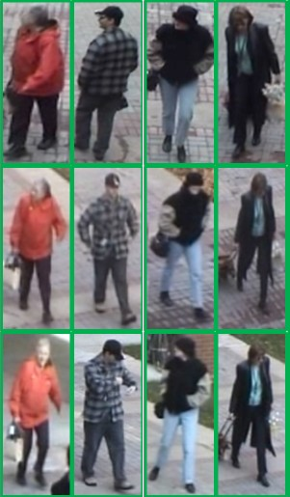

Slide 5
Challenge
significant variations of resolutions, lightings, poses and viewpoints
discriminative and robust features

Slide 6
Approach Architecture
Person over different views
Feature Extraction
Distance Metrics

Slide 7
Approach Overview
Passive Biometric
face
Overall Appearance
HOG Log-RGB
HSV + edge
Weighted Region Matching
Parts-Based modeling

Slide 8
Face identification
Out-standing features
high quality image
pose variation
Notes:
Because objects
captured by surveillance cameras are often small in size and a lot of visual details such as facial components are
indistinguishable in images, some of them look similar in appearance.

Slide 9
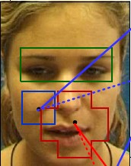
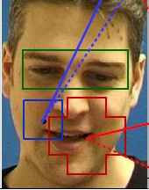



Face identification

Slide 10
HOG Log-RGB
Notes:
HOG表示轮廓信息

Slide 11
Bag-of-features model
离线学习得到量化值集合
对当前目标的HOG特征进行量化
计算特征直方图
L1范式计算距离

Slide 12
HSV-edgel
e:主要边缘信息（by salient edgel extraction）
:边缘在x处的方向（水平或竖直，1bit）
:边缘两侧区域R分量的比值（量化为4个可能的值，2bits）
边缘信息共7bits表示
Notes:
颜色 边缘

Slide 13
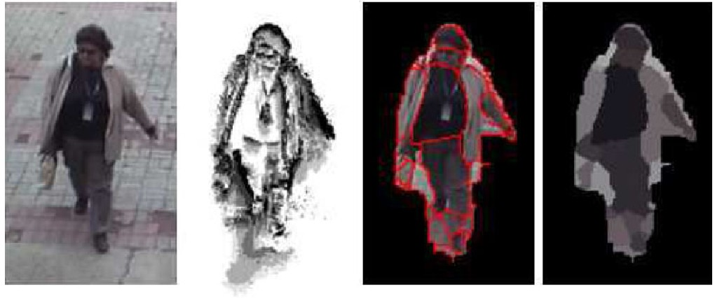

Slide 14
Bounding box model
直方图由两部分组成，一部分表示颜色特征，另一部分表示边缘特征
距离计算

Slide 15
Weighted Region Matching
Face detection : high quality photographs to get body details.
This algorithm: human identity recognition over low quality aerial images.

Slide 16
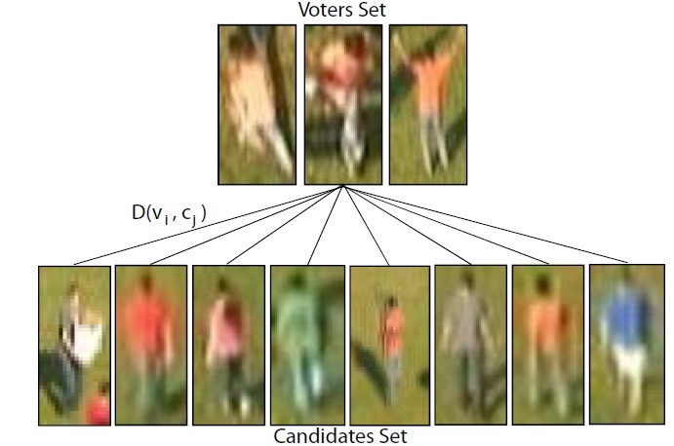
Problem Definition
Notes:
Voter set 为待匹配目标的不同姿态， candidates set 为场景中检测到的人，作为候选

Slide 17
Problem Definition
表示 与待匹配目标的相似度
表示距离计算
为常数
为 的权重系数
确定距离和权重

Slide 18
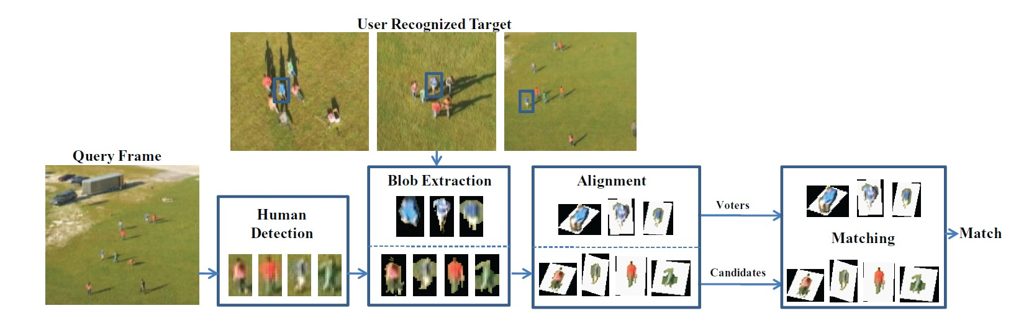
Architecture

Slide 19
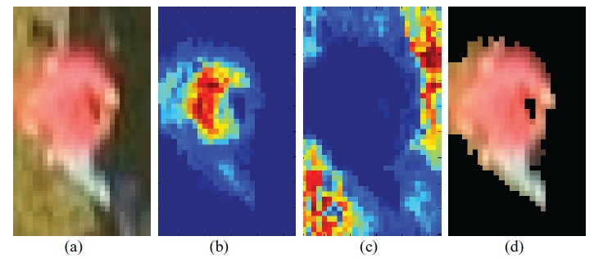
Human Detection && Blob Extraction
HOG 行人检测
kernel density estimation (KDE) 前背景分离

Slide 20
Alignment
相机角度和行人姿势不同，不能直接进行对比
对所得blob按照统一标准进行重新排列，得到一致状态后再进行对比
HST model
Active Appearance Model (AAM)进行位置校正

Slide 21
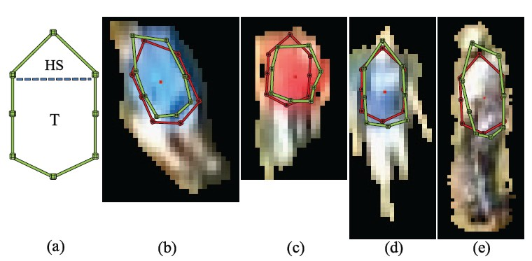
Alignment
Notes:
HST 8特征点模型，确定行人姿势；AAM对HST进行校正，得到最佳的HST模型位置

Slide 22
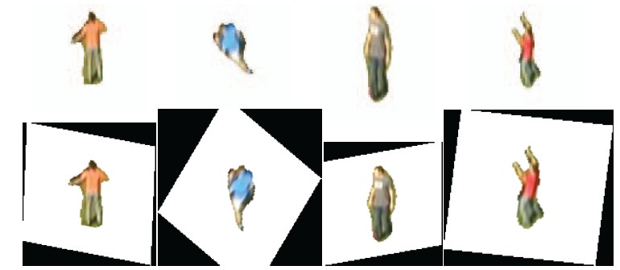
Alignment
根据HST，对图像块按某一姿势进行重新排列

Slide 23
Measuring the Distance Between Blobs
Meanshift 利用颜色特征将图像划分为若干区域
每个区域提取HSV和HOG特征，得到直方图
计算对应区域间的距离

Slide 24
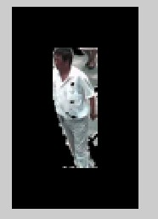
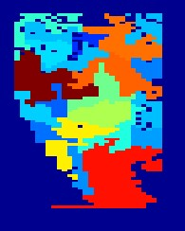
Mean shift 区域分块

Slide 25
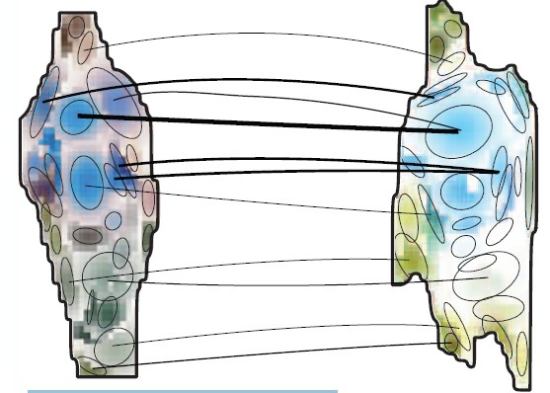
The distance between blobs
Notes:
Every blob is a set of signatures
(regions) where a ground distance relates every two region
pair. EMD performs many to many matchings between the blobs’
signatures. Connections in the figure represent the EMD flow matrix
associations. Some connections are suppressed for clarity.

Slide 26
The distance between blobs
Earth Mover Distance (EMD)
every blob is a region set
every region is denoted by a feature histogram vector and a weight.
a region from one blob can be related to more than one from the other

Slide 27
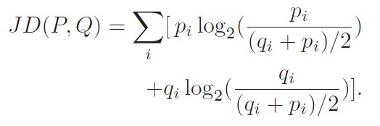
The distance between blobs
P,Q为特征向量，X为区域中心坐标位置

Slide 28
Determining the Voter’s Weight
Each region in the voter blob has certain information about the target
assign a weight for every region such that the most consistent regions are given higher weights, because they are more probable to lead to the target identity.

Slide 29
PageRank
a voter’s region r_{i} that holds vital information about the target will be consistent across the voters
other voters will contain regions that are close to r_{i} in the feature space.
noisy regions are inconsistent; therefore, they are more likely to be connected to highly separated regions.

Slide 30
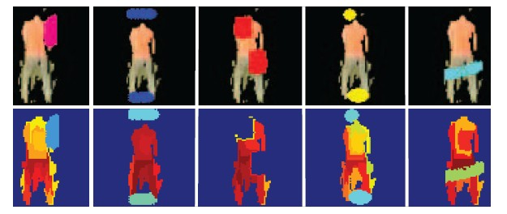
PageRank

Slide 31
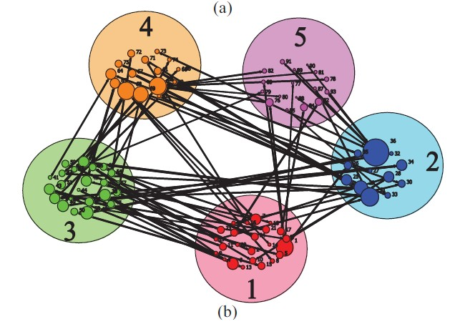
PageRank weight

Slide 32




Region weight
page rank weight
normalized size of the region

Slide 33
Our method
行人检测
前景分割
特征提取
距离计算

Slide 34
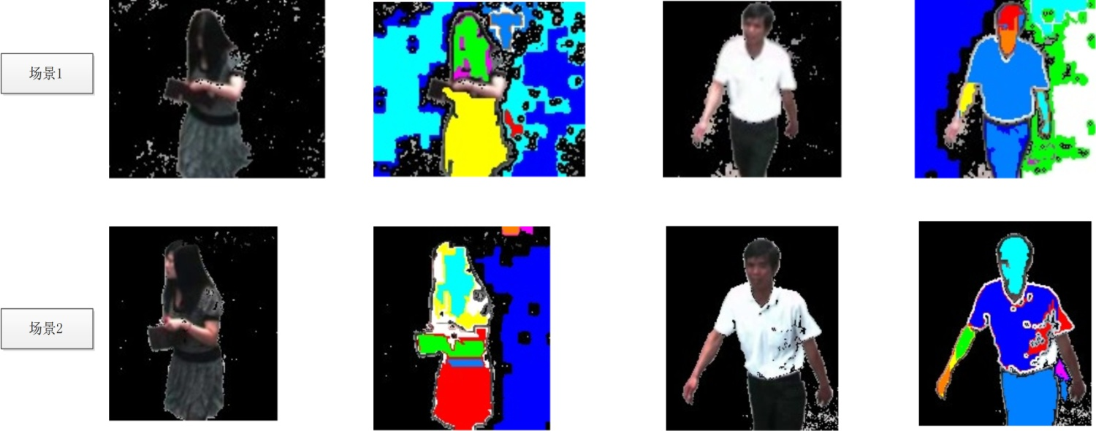
特征
MSER直方图
Moreover

Slide 35





MSER + 颜色
MSER + 轮廓
？

Slide 36
特征
以mser划分区域，进行特征提取

